Slide 1

Data science final project
Main question:
Can we predict position of a player in FIFA by his stats ?
Presenters:
Matan Sharazki
Elad Asis

Slide 2
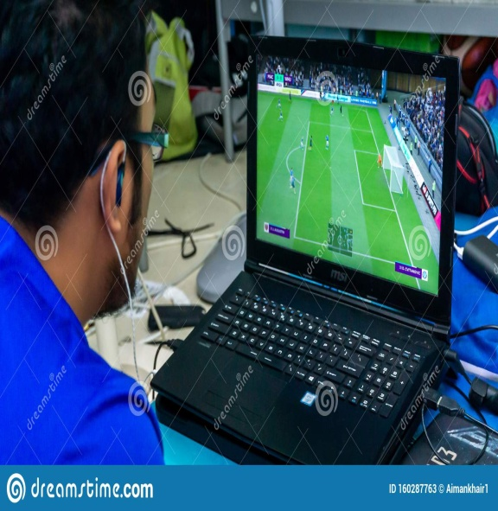
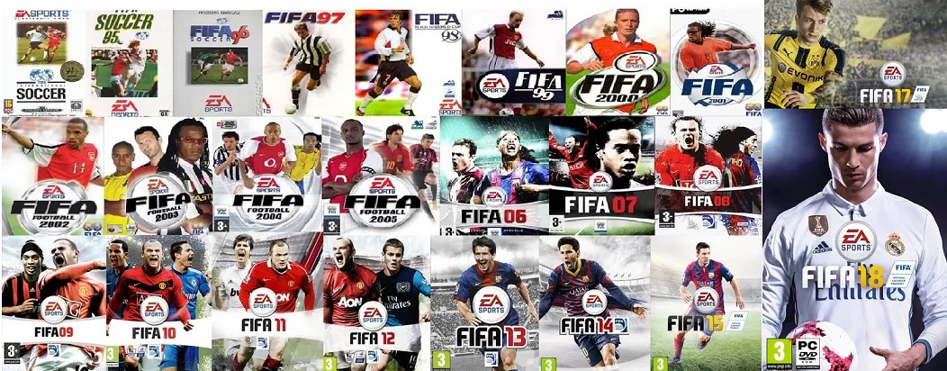
What is FIFA?
FIFA is a series of association football video games developed and released annually by Electronic Arts under the EA Sports label. As of 2011, the FIFA franchise has been localised into 18 languages and available in 51 countries.
The player stats depends on his position, in a different position a player gets a different stats.
Many people in the world (including us) playing on FIFA online and check the stats of the player before buy him.

Slide 3
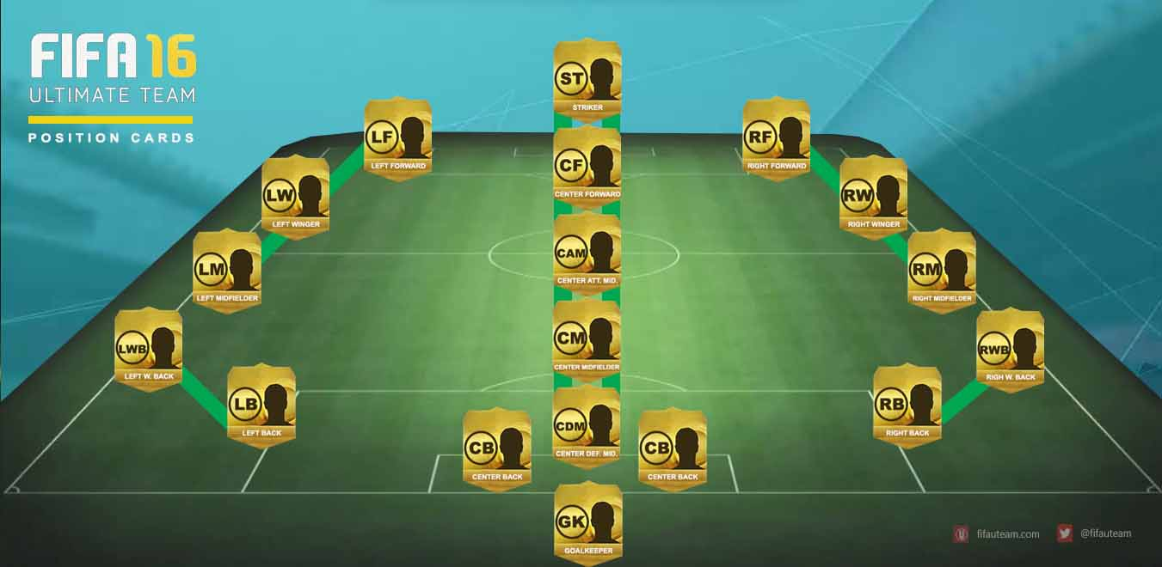
Why a player position in FIFA?
We really like football games, and playing at FIFA
Many people in the world (including us) playing on FIFA online and check the stats of the player before buy him.
We would be very happy if there would be a machine that would tell us where a player should play by his stats

Slide 4

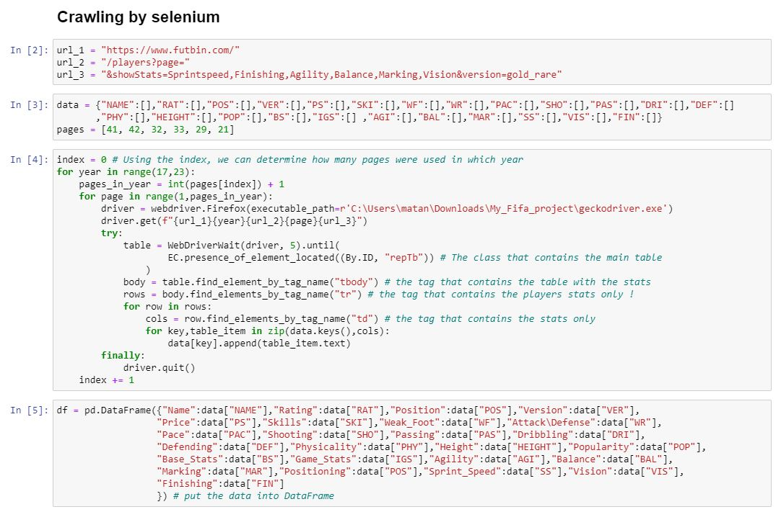
Crawling

Slide 5
Web crawling by using selenium
We performed crawling in on site FIFA 22 Ultimate Team Prices, Squad Builder, Draft and Players Database | FUTBIN - The site has a lot of data about each, and every player in FIFA, and past data is also saved.
We performed data acquisition with Crawling, using Selenium, we ran on player statistics between 2017-2022 to get enough data as required in the project.
We cut the URL into 3 parts, to add the year and the pages we will go through on the site.
We slept between pages (Driver, 5) so as not to get blocked.
We went through the HTML page of the site to know how to purchase the data we want.
We got Data frame 5862 X 25.

Slide 6
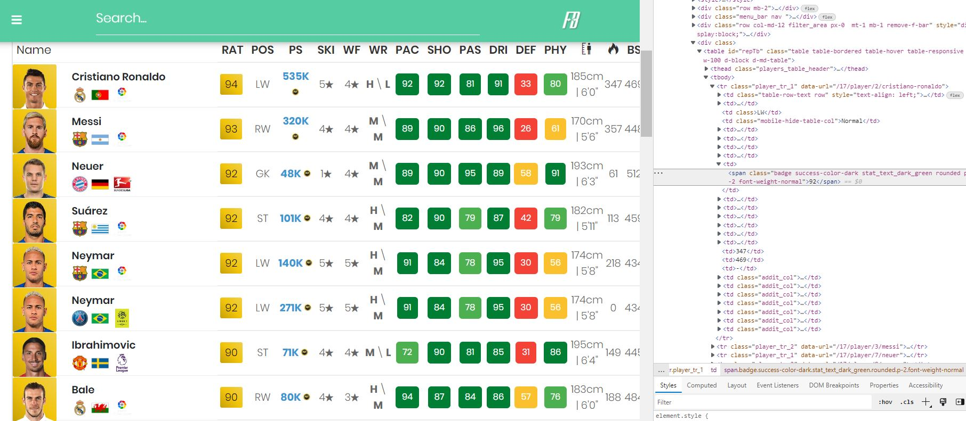
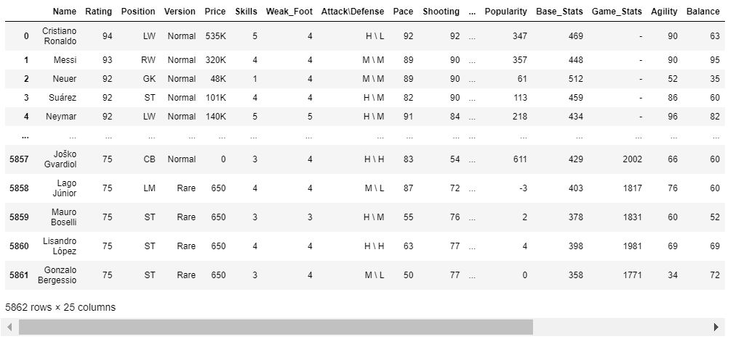

Slide 7

Data cleaning

Slide 8
Our data cleaning step
We performed an initial treatment of our data, deleted unnecessary columns that could not affect the result (like price, rating), and then deleted duplicates (using drop_duplicates).
In the Height column we got height in centimeter and inches and sometimes also the weight of the player, we only left the height in centimeter so as not to create problems.
We deleted rows that lacked information, and rows of players whose role is a goalkeeper (GK), because goalkeepers have statistics other than the player (like leap, ball grip, reflex).
We have changed the position of a player from letters to numbers - CF-1, LF / RF-2, CB-5 .
Statistics that numbers was with a decimal point, we became an int type variable.
We deleted rows of players in the same position, to compare the number of players in all positions.

Slide 9
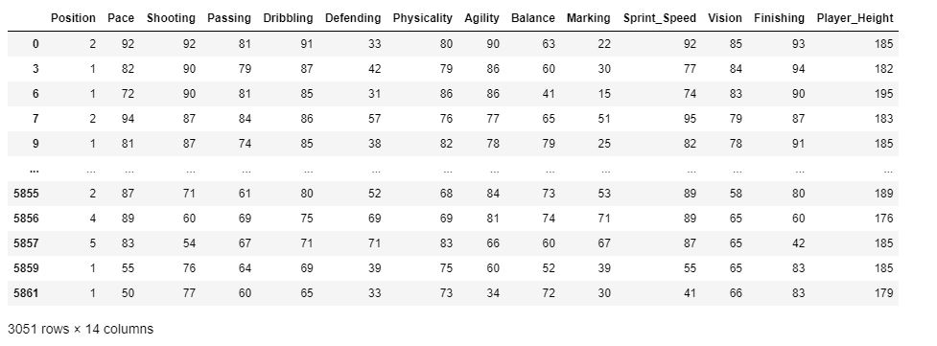
Our new data set

Slide 10

EDA Exploratory Data Analysis

Slide 11
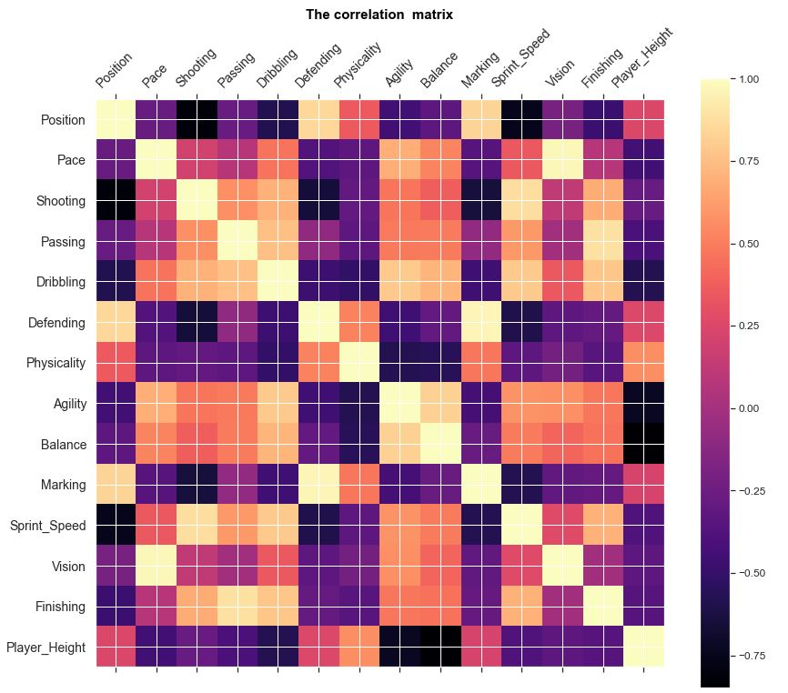
The correlation matrix

Slide 12
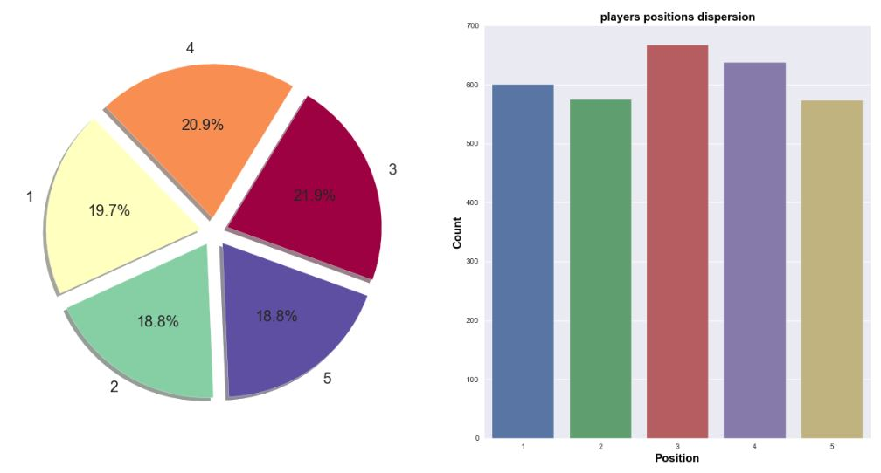
the players positions dispersion

Slide 13
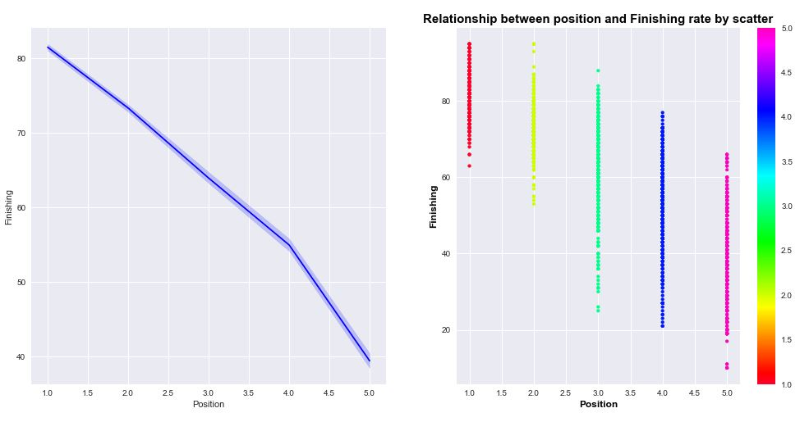
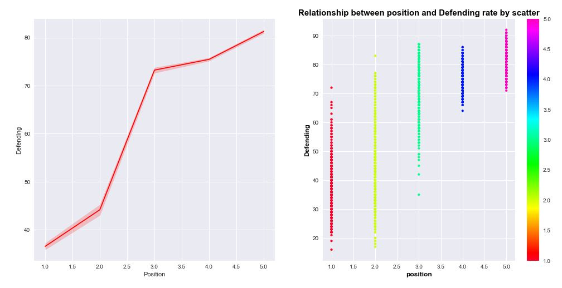
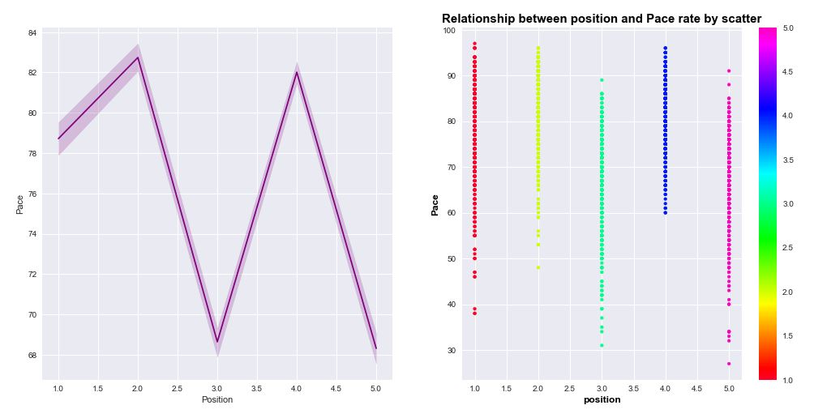
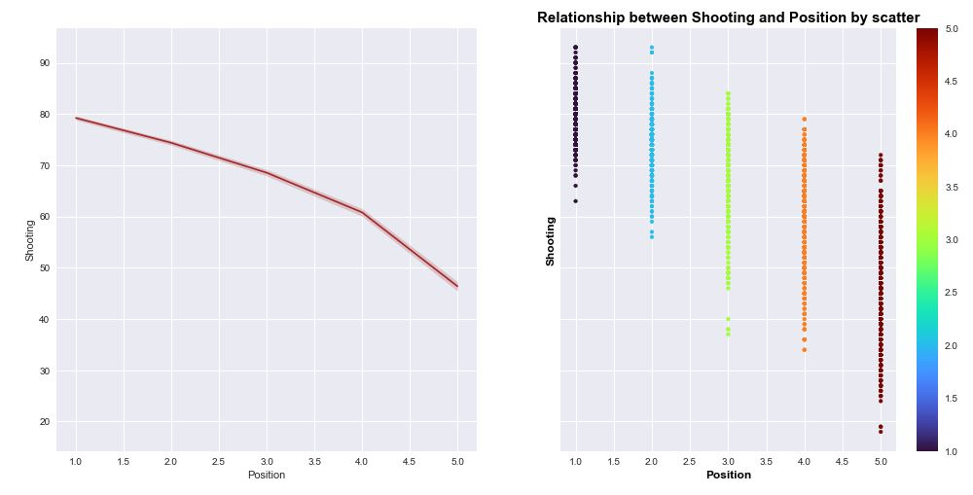
Relationship between position and Finishing rate by scatter Relationship between position and Defending rate by scatter Relationship between position and pace rate by scatter Relationship between Shooting and Position by scatter

Slide 14
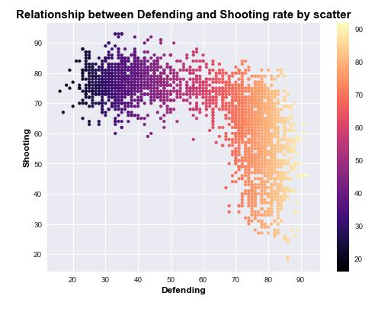
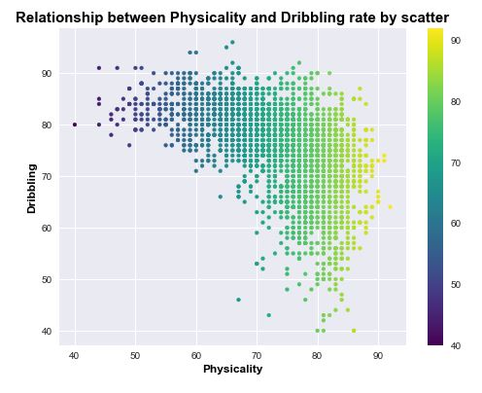
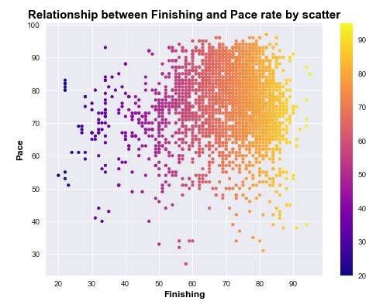
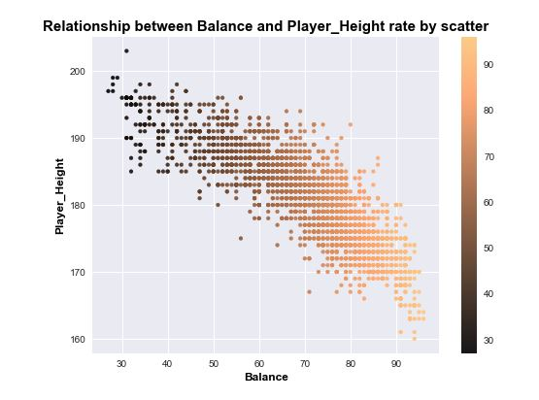
visualization

Slide 15

Machine Learning

Slide 16
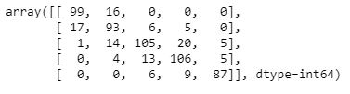
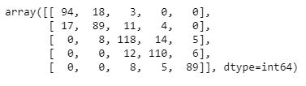
The Steps
In the first step we did was to split the data to train and test. The train contains 80% of the data and the test contains 20% of the data.
We set the y for the target column and the X for the rest.
In the second step we run 2 models (decision-Tree and KNN), to see which was the most accurate and return the best prediction.
The matrix of ‘Decision-Tree’:
The matrix of ‘KNN’:

Slide 17
Decision Tree
KNN

Slide 18
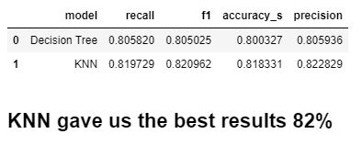
We used supervised machine learning because we has a target column – the player position. We used Decision-Tree and KNN as our machine learning process. To check the score we used recall, f1, accuracy and precision scores.
Scores:

Slide 19

References

Slide 20
Our data cleaning step
https://www.futbin.com/
https://pandas.pydata.org/docs/
https://stackoverflow.com/
https://matplotlib.org/stable/tutorials/introductory/pyplot.html
https://www.machinelearningplus.com/plots/top-50-matplotlib-visualizations-the-master-plots-python/#32.-Pie-Chart
https://fifauteam.com/fifa-21-positions/

